Slide 1
Support and resistance
Support and resistance are areas on a market’s chart that it has difficulty breaking past. If a market reaches its support or resistance level, then a price reversal may be on the cards.

Slide 2
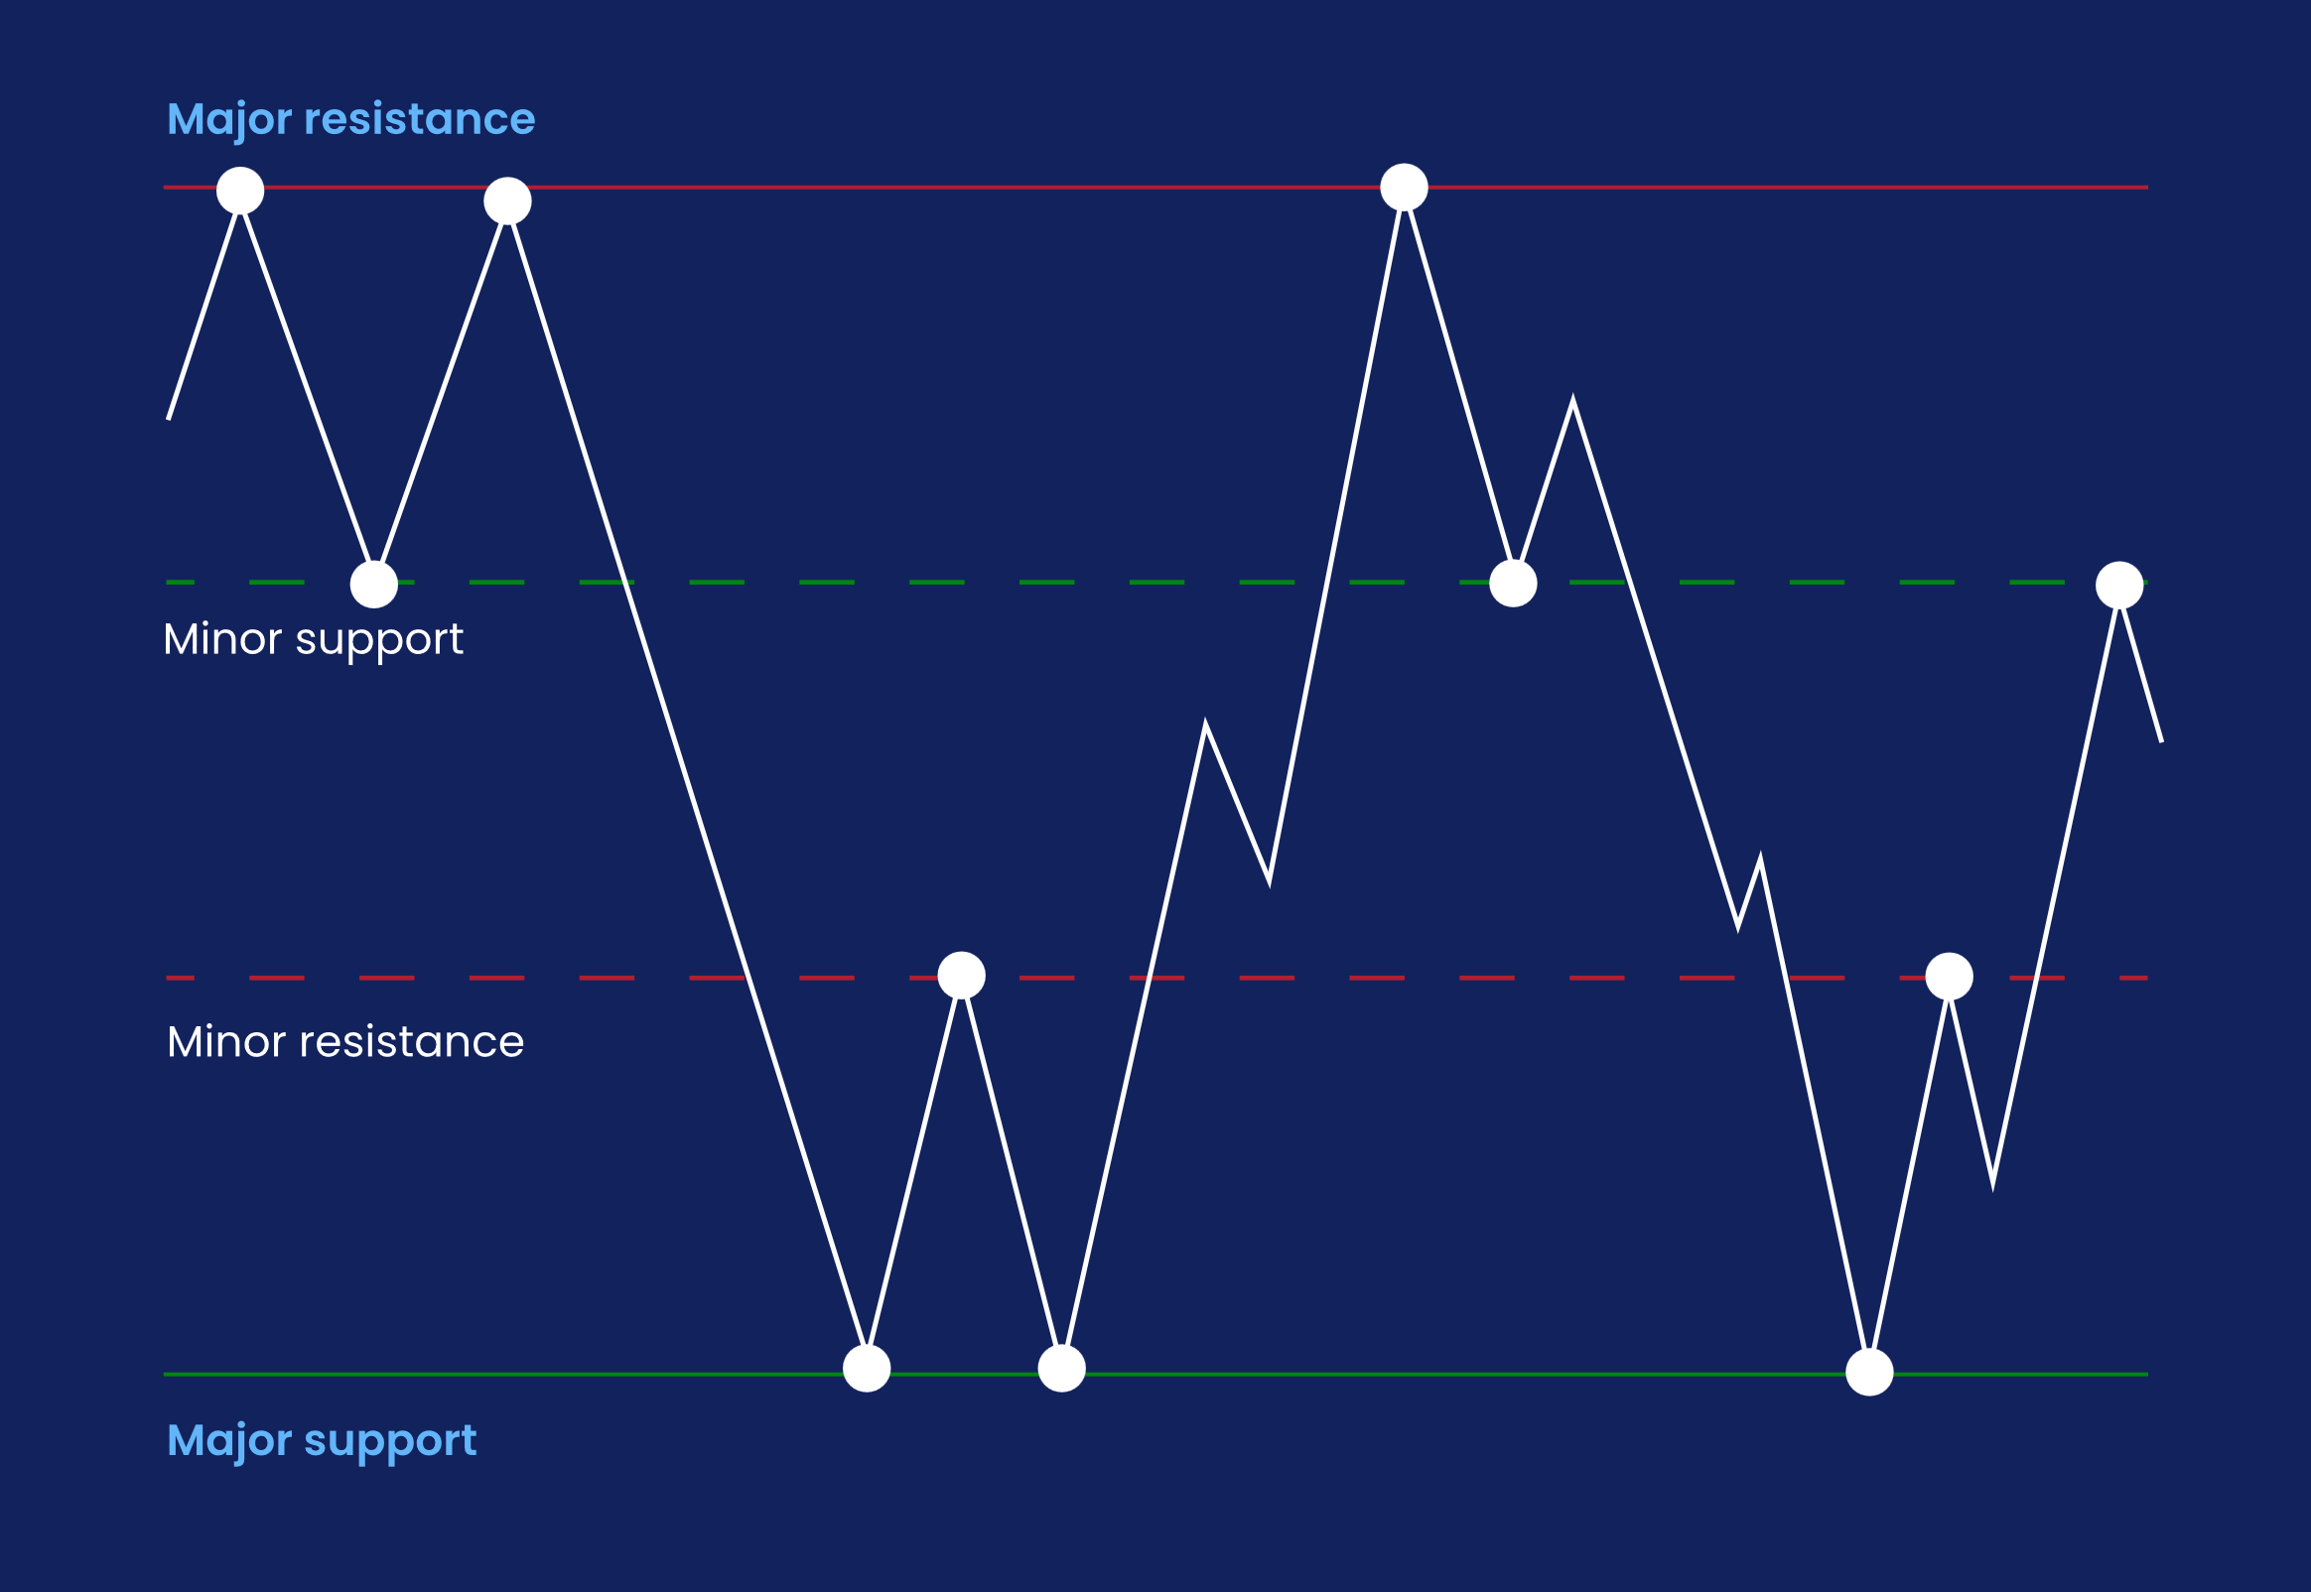

Slide 3
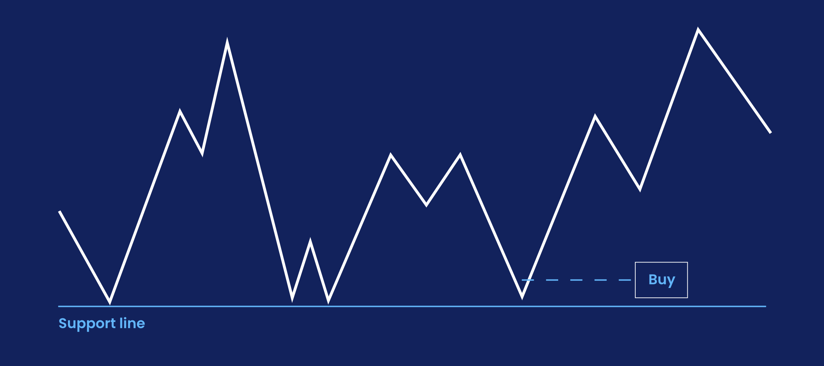

Slide 4
Channels
You can also use trend lines to identify channels. Channels are comprised of two parallel lines, with a market’s price action bouncing between them. To find a channel, draw two trend lines – one between two high points on a chart, and one between two low points.
If the market’s price action remains between these two lines, then you can trade the channel by selling at the top and buying at the bottom.

Slide 5
Volume
One useful tool when looking for trends is volume. Volume tells you how much a security has been traded in any given session, and can offer insight into how strong a move is. If a market is on the up, but barely anyone is buying it, the move may not have enough momentum to continue for much longer.

Slide 6
Trading with patterns
While they can be useful for predicting price action, when a pattern emerges there’s no guarantee of what will happen next. So, most traders will wait to confirm their anticipated move – whether it’s a new trend, a reversal or a continuation – before opening a position.
What this means in practice is that they’ll wait for a few periods to check that the market is behaving in the way they predicted.
As ever, careful trading and strong risk management are also key.

Slide 7
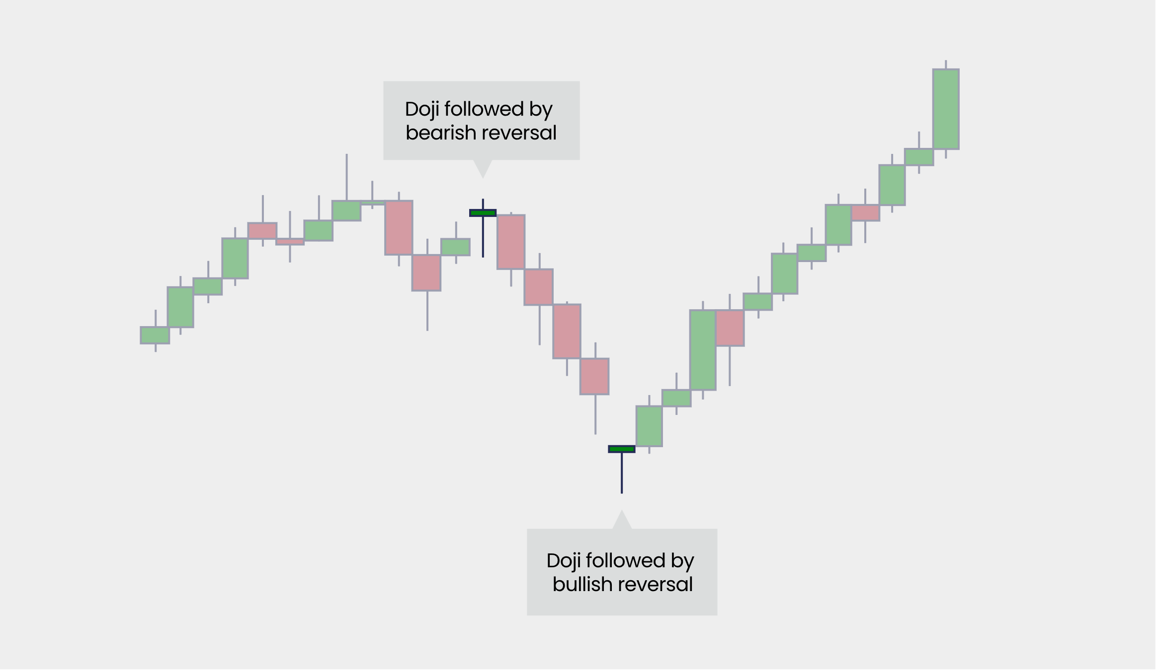

Slide 8
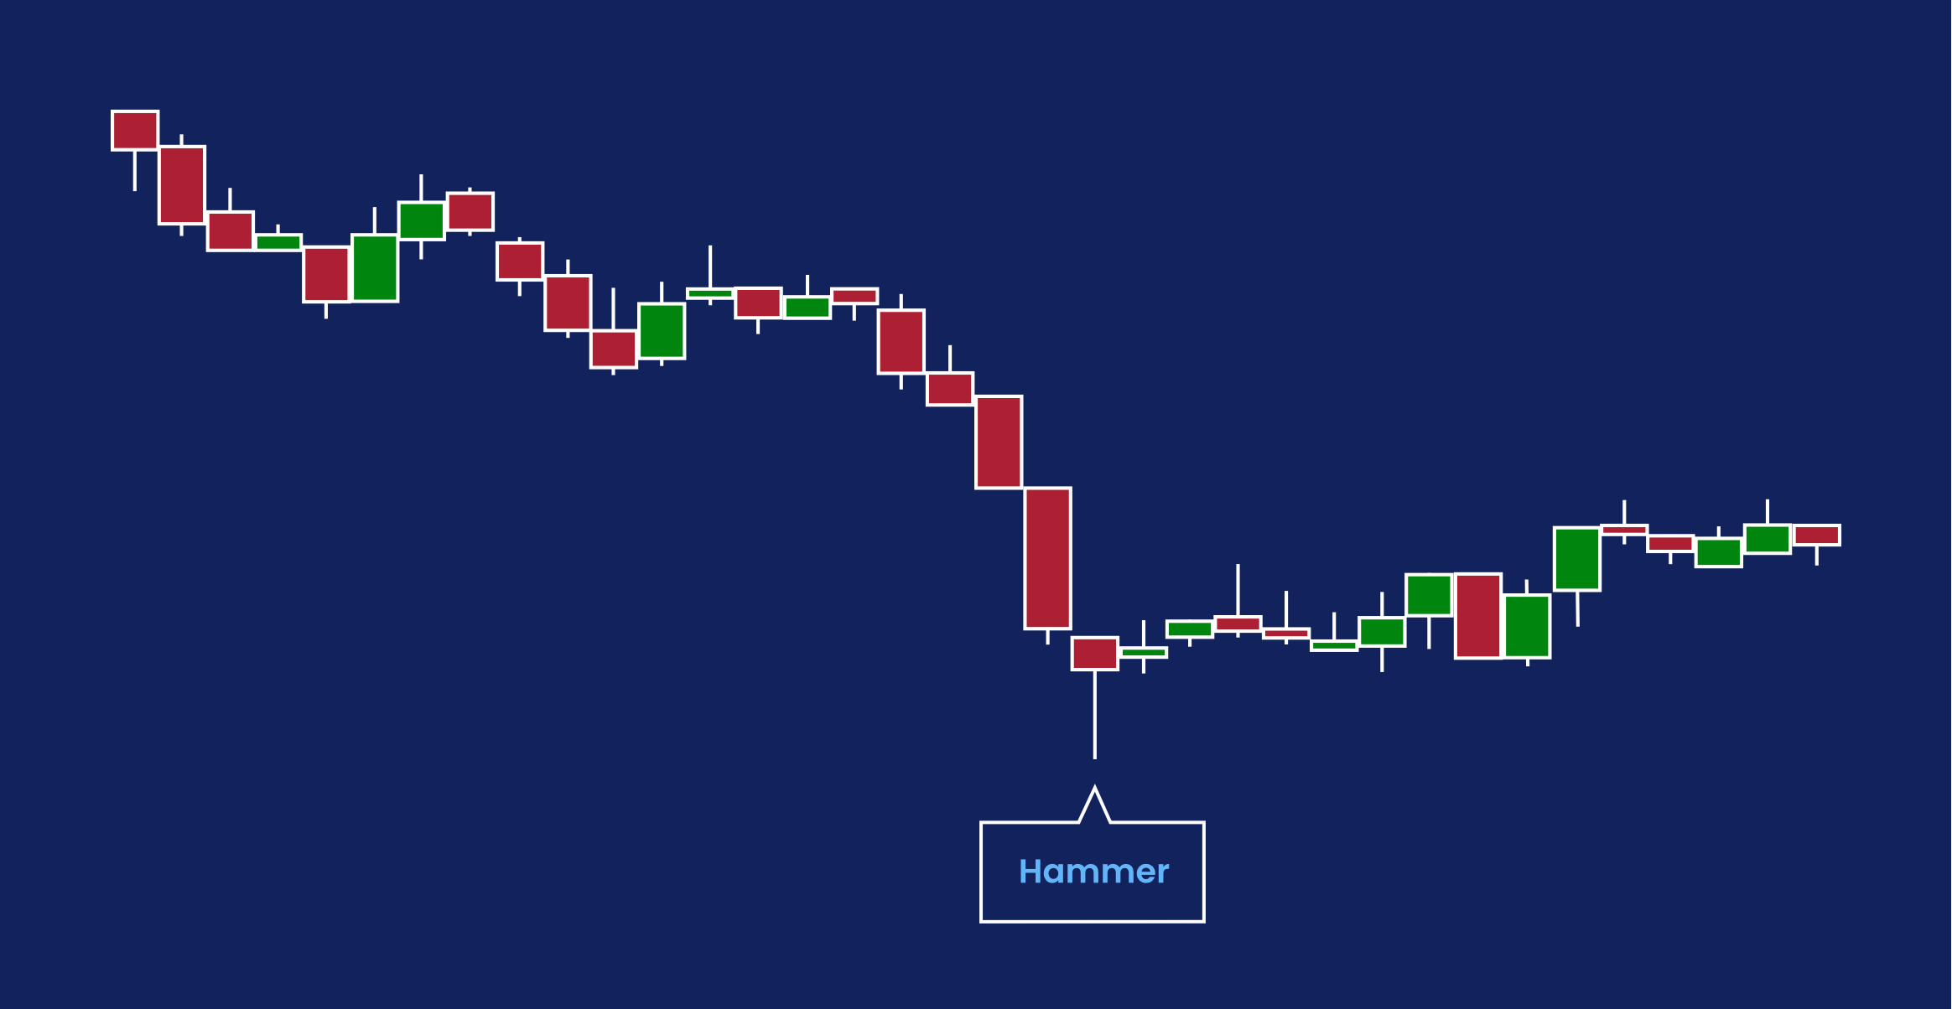
Hammer
But what if a hammer appears at the end of a bull run instead of a bear one?
This is also a reversal pattern, but in this case, it signals the potential end of the uptrend. And it isn’t called a hammer – it’s called a hanging man.

Slide 9
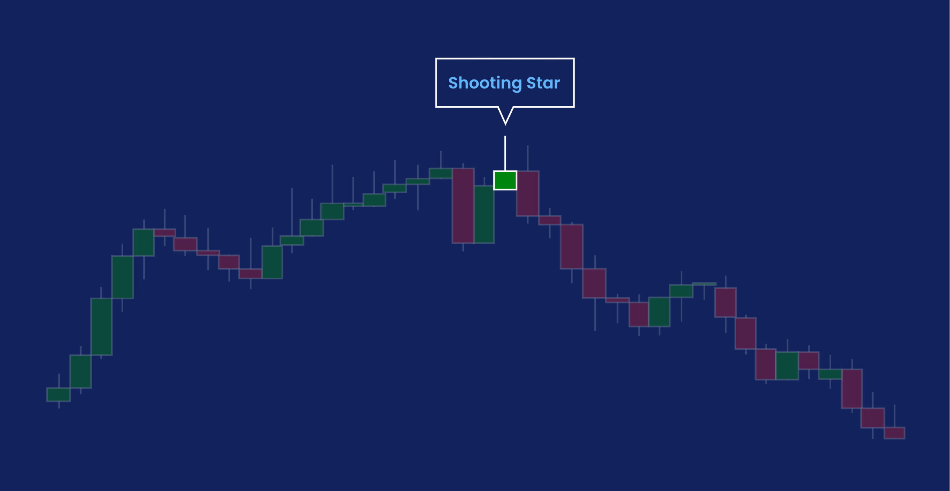
Hanging man
In a hanging man, sellers took over during the session to postpone a rally. Buyers then pushed the price back up but weren’t able to send it much past the open. Which means buying sentiment may no longer be strong enough to sustain the uptrend.
Inverted hammer and shooting star
You can also look for upside down, or ‘inverted’ hammers. These are also reversal patterns, appearing at the end of bear runs and signaling a potential end to the downtrend.
If an inverted hammer appears after a rally, it is known as a shooting star. Again, it is often taken as a sign that the uptrend may be nearing its end.

Slide 10
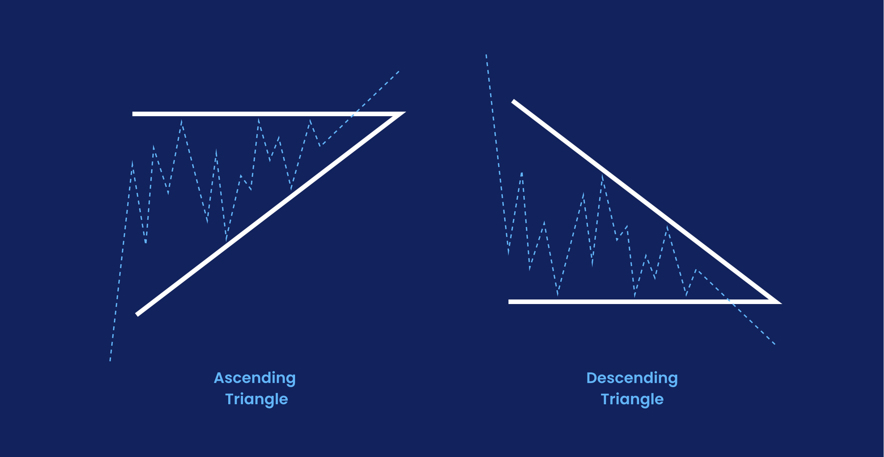
Triangle
There are three types of triangle to watch out for: ascending, descending and symmetrical.
It’s often a good idea to place a stop just beyond the opposite trend line. Then, if the pattern fails, your position will close automatically.

Slide 11
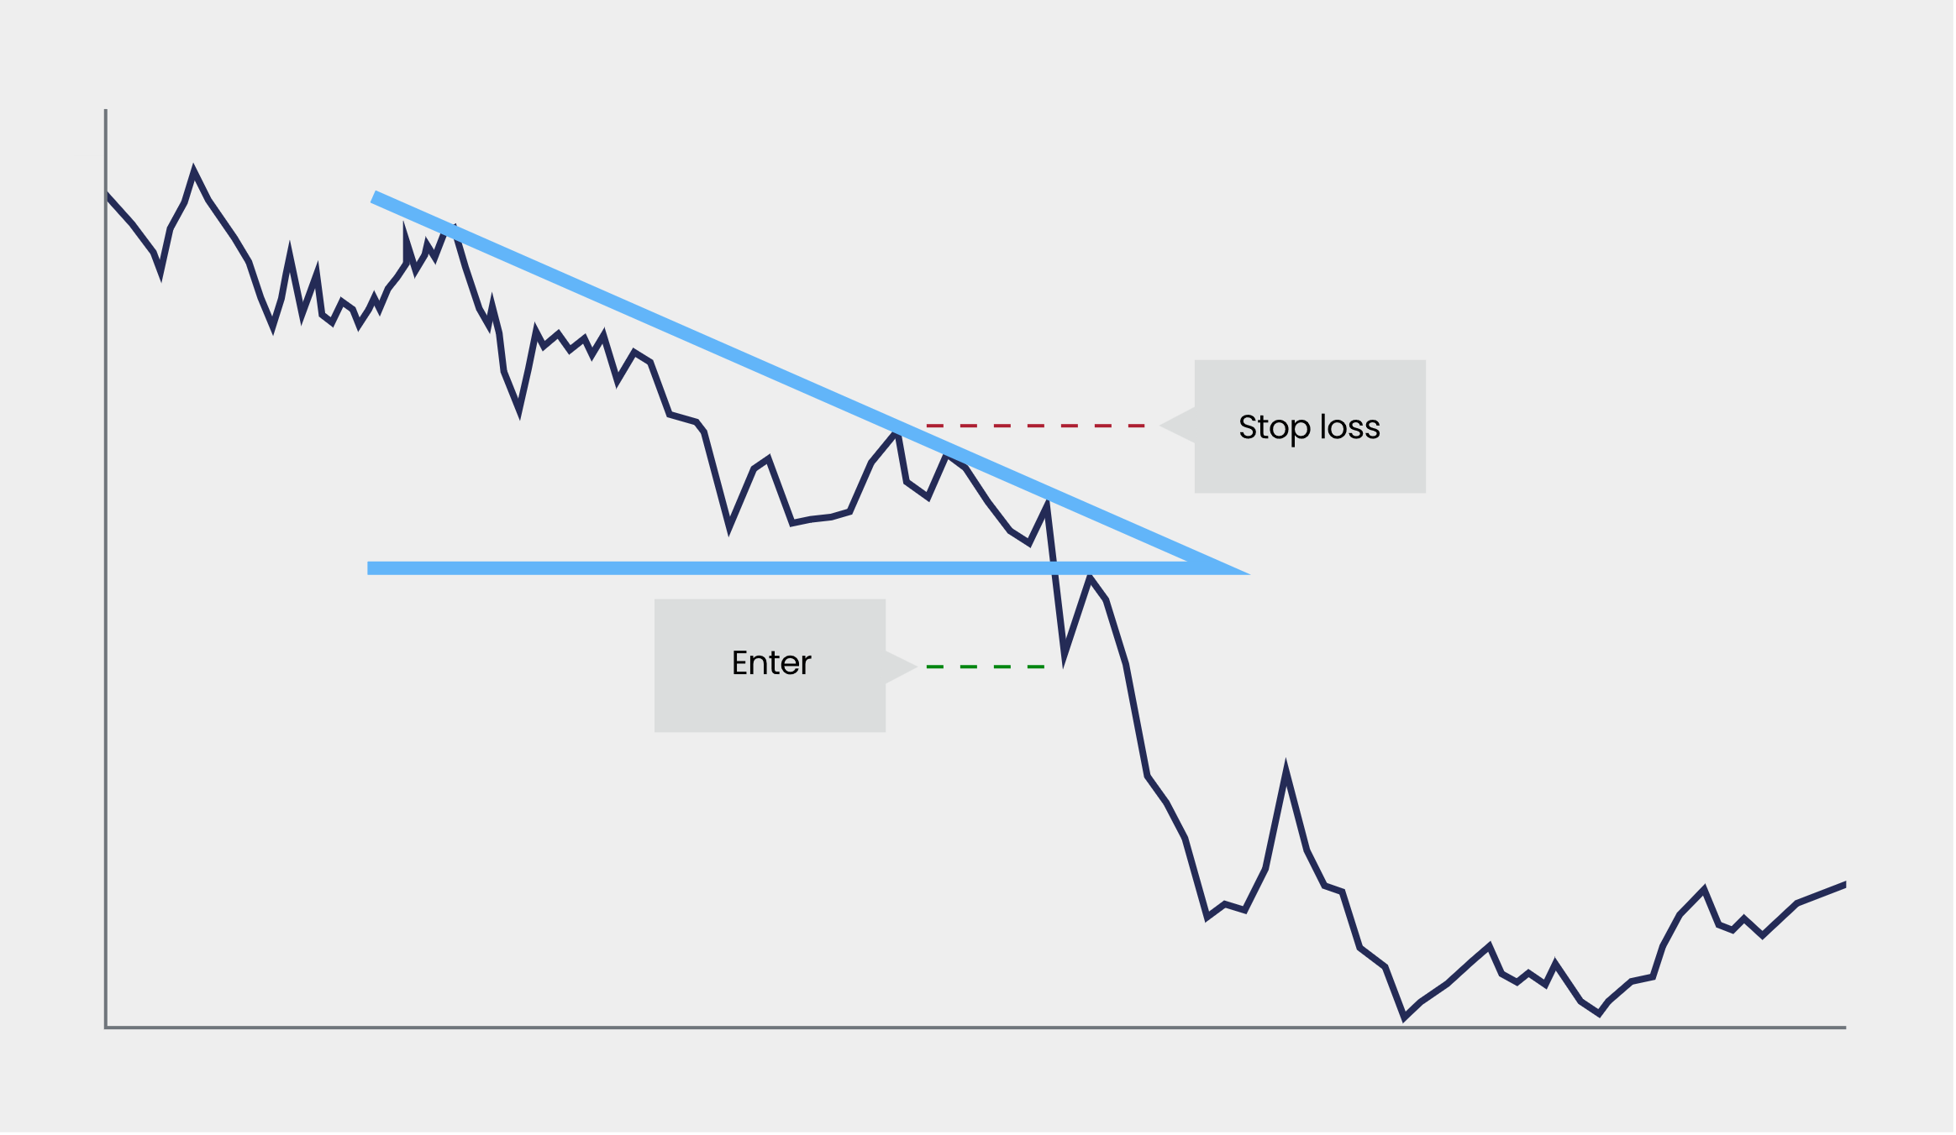

Slide 12
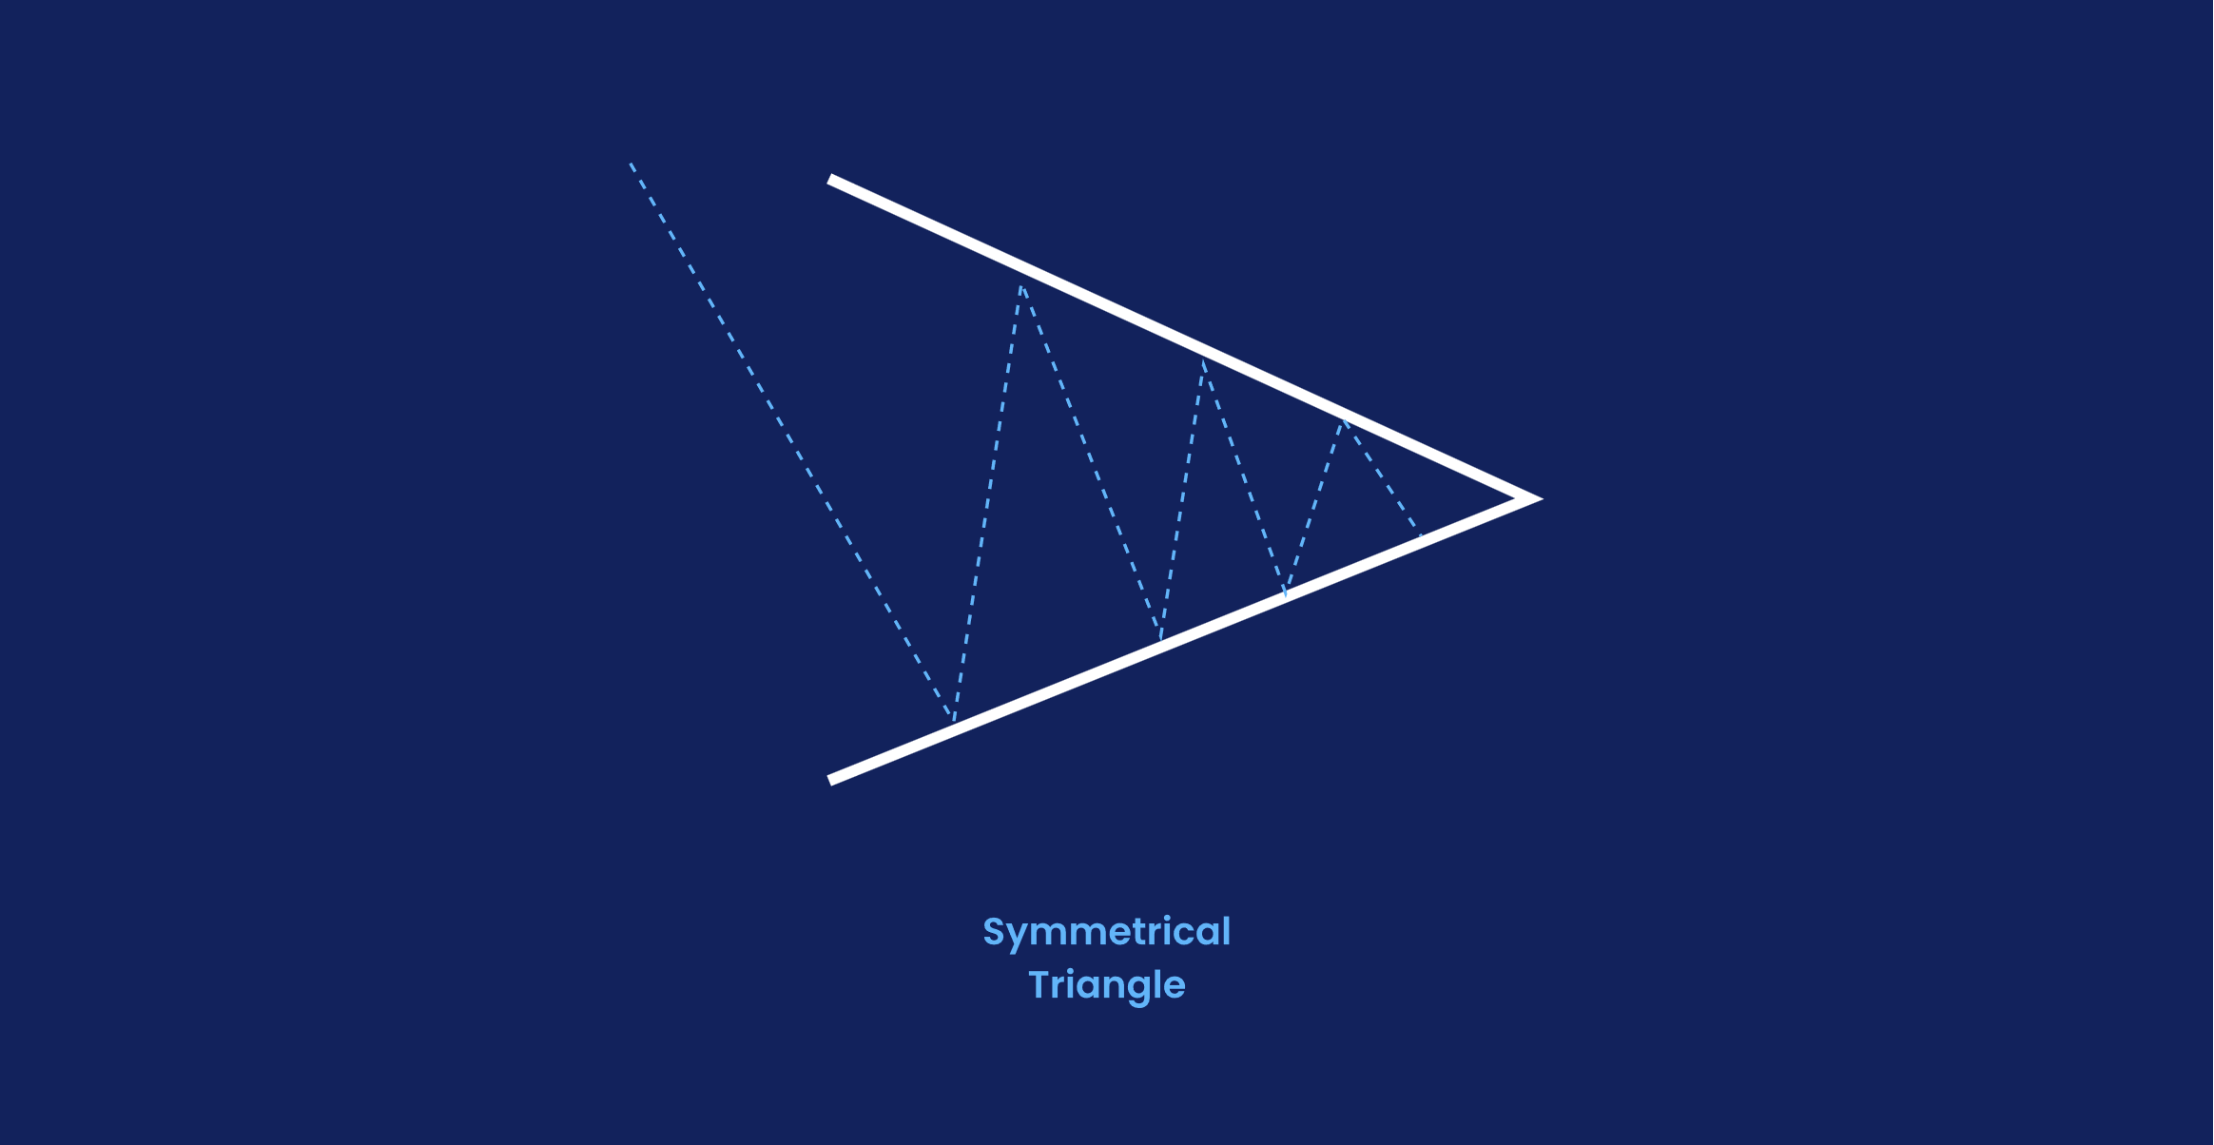
Symmetrical triangles, flags, and wedges
In a symmetrical triangle, two trend lines point towards each other. The first connects a series of lower peaks, while the second connects a series of higher troughs

Slide 13
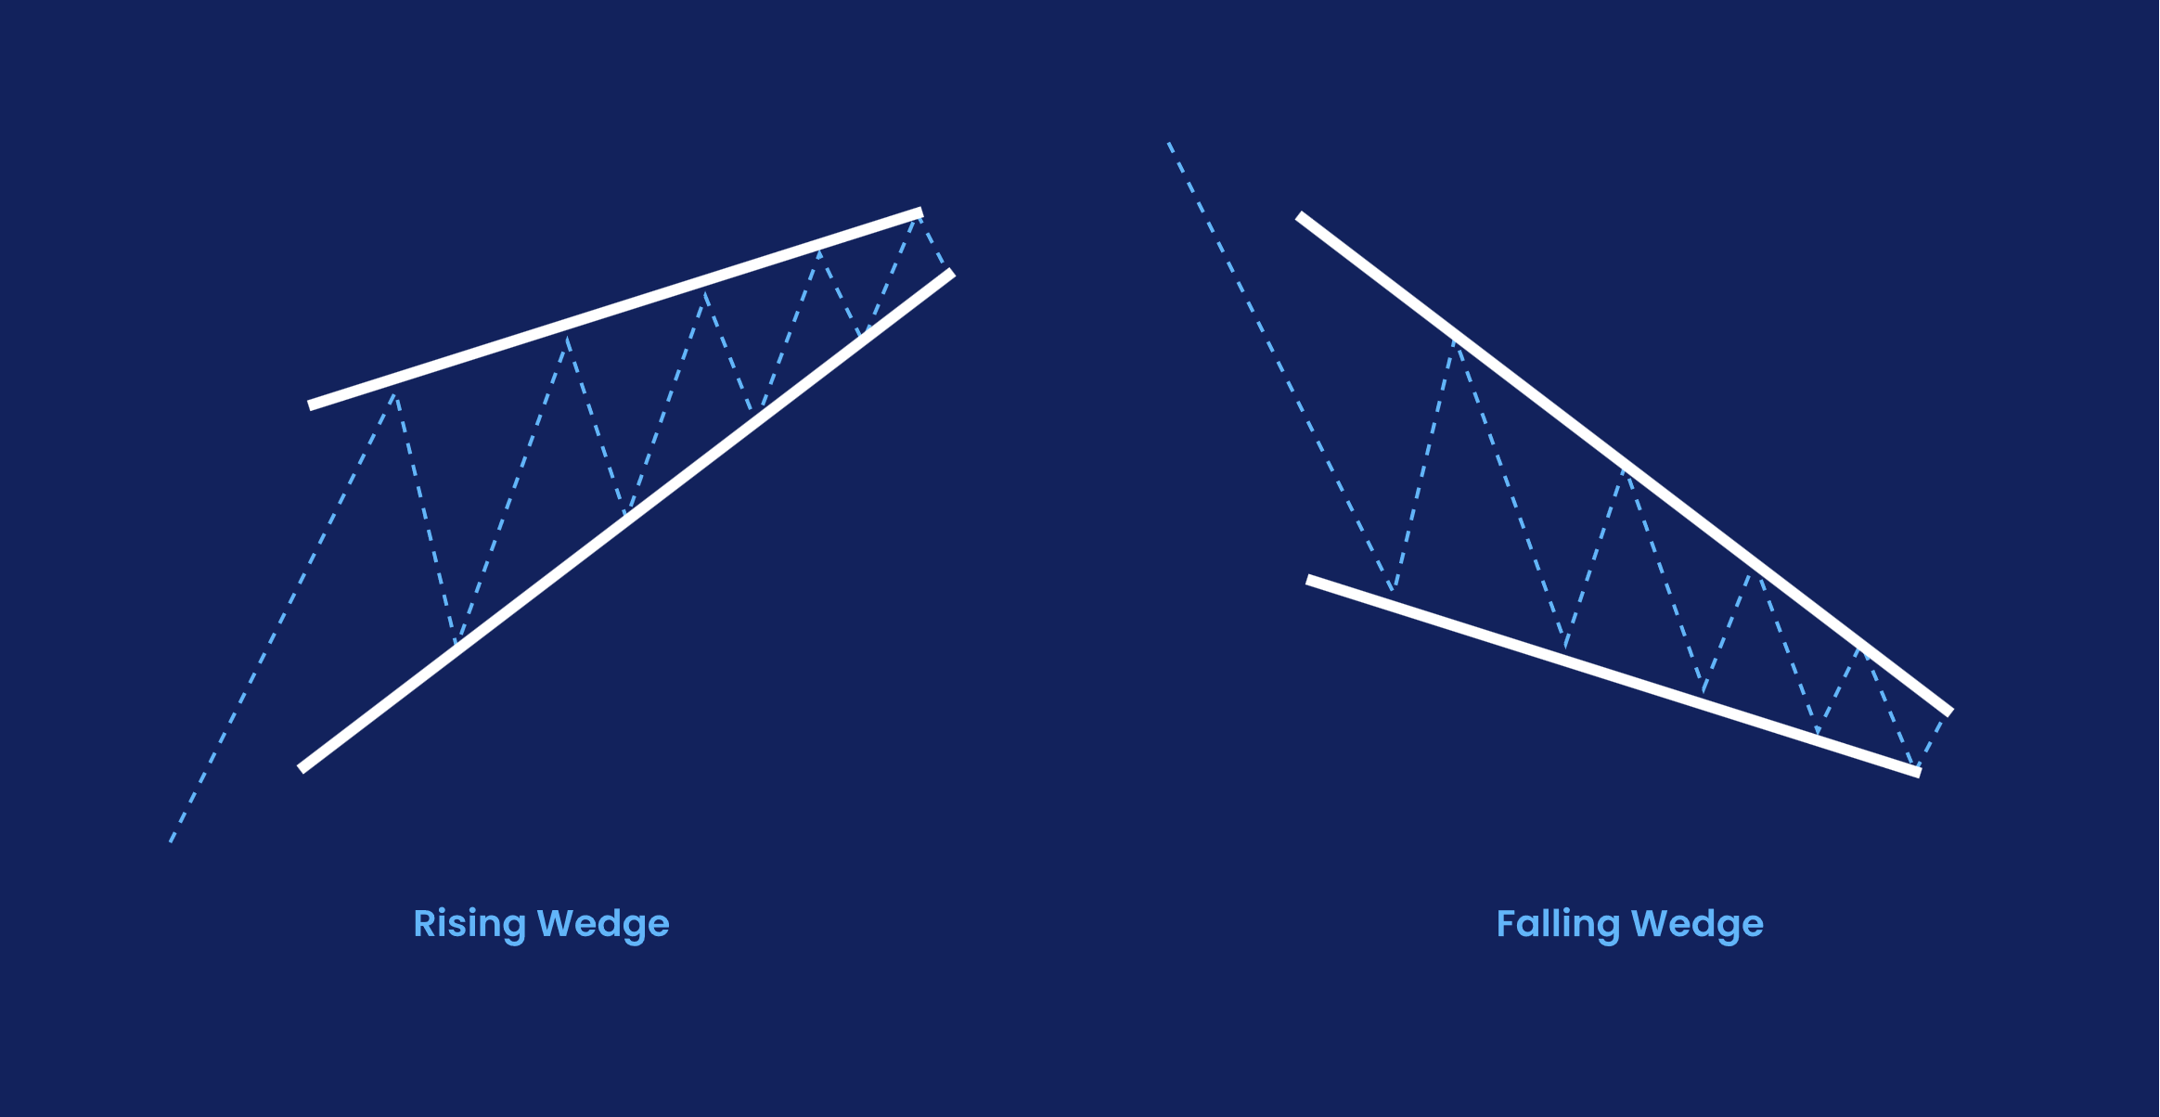
In a symmetrical triangle, two trend lines point towards each other. The first connects a series of lower peaks, while the second connects a series of higher troughs

Slide 14
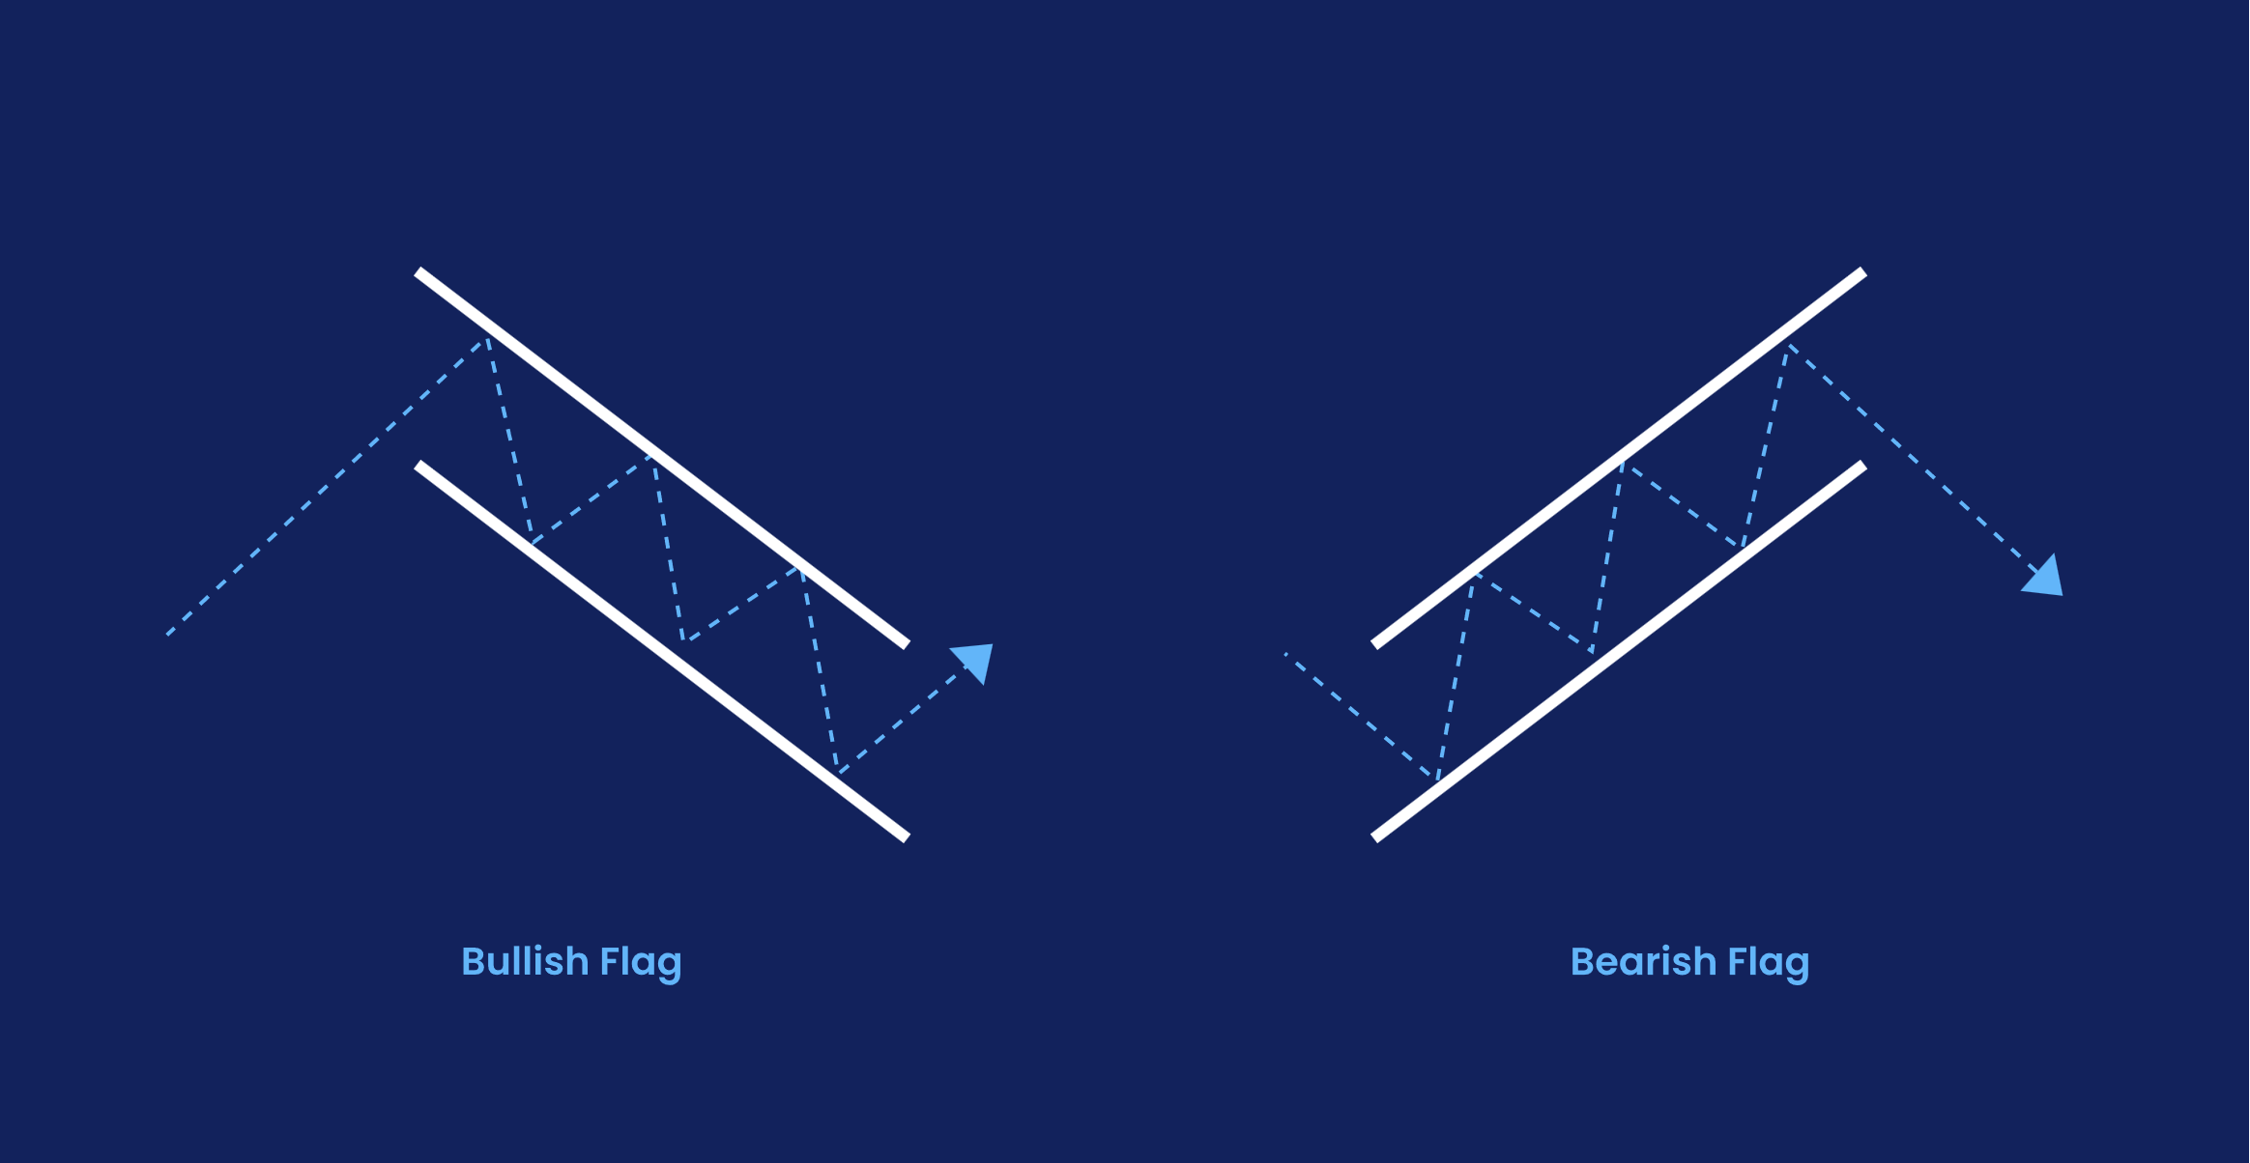
In a flag, two trend lines run in parallel while sloping either down (a bullish flag) or up (a bearish flag). Bullish flags appear after a significant move up, while bearish ones appear after a downtrend

Slide 15
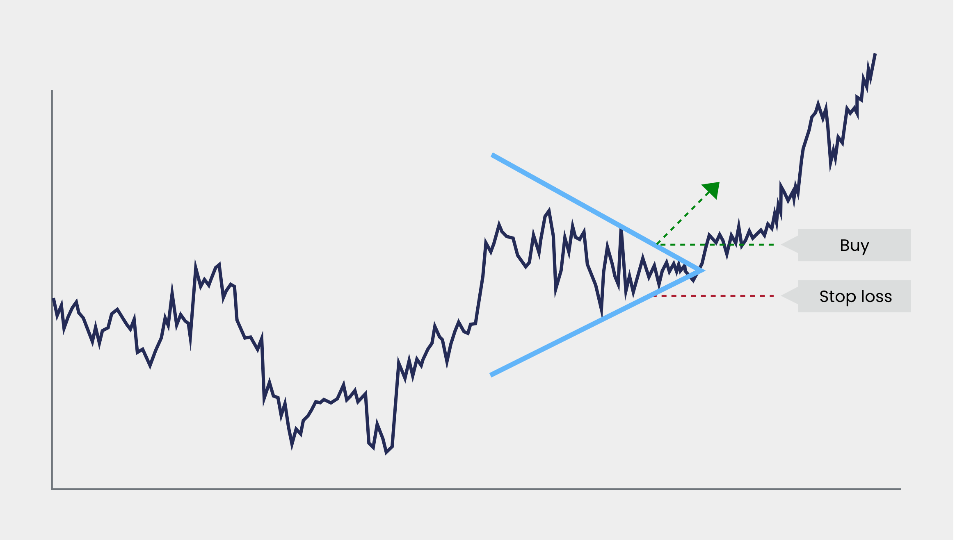
If the market breaks up, then it may start a rally. If it breaks down, it may signal a bear run.
You can trade any of them by entering a position once the market moves beyond either trend line. Again, it is often a good plan to set a stop just beyond the opposite line, in case the move fails.

